Slide 1
NF Brush Meeting
12/14/2021
Takashi Yokokura, Rui Wang
Erika Ding, Sanjay Kumar

Slide 2
Model (Planar surface)
Uniform grafting distribution
Linear chains
3 chain “types” (L/M/H)
Parameters can be individually controlled for each type

Slide 3
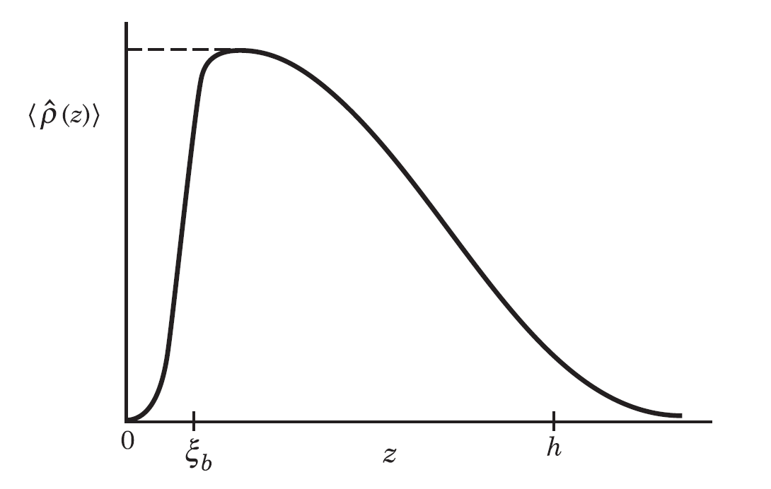


Tunable Parameters
Block 1
Salt concentration ($C_{± }$)
Grafting density
Total ($σ$)
L/M/H Stoich. Ratio
Chain architecture
Number of blocks (K)
Charge distribution ($α_{i}$)
Chain length ($N_{i}$)
Solubility/Hydrophobicity ($χ_{i}$)
Temperature
Solution pH
Block 2
Block K
$$\{χ_{N},N_{K}, α_{K}\}$$
Brush Height (H)
Density(z)
z-axis

Slide 4
Block determinations

Slide 5
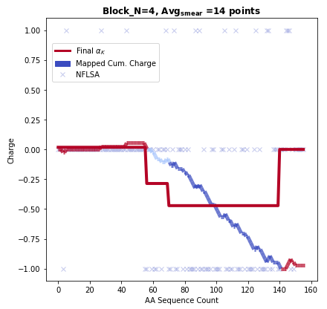
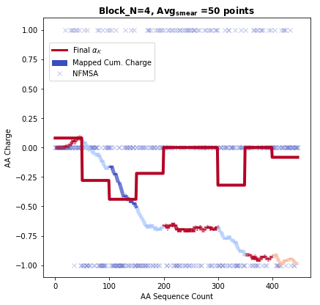
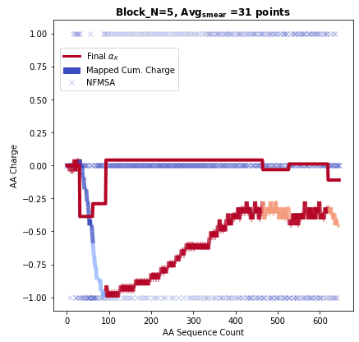
Assuming H tag neutral
Blocks separated by similarity in local charge
(See 20211118 Group Meeting)

Slide 6
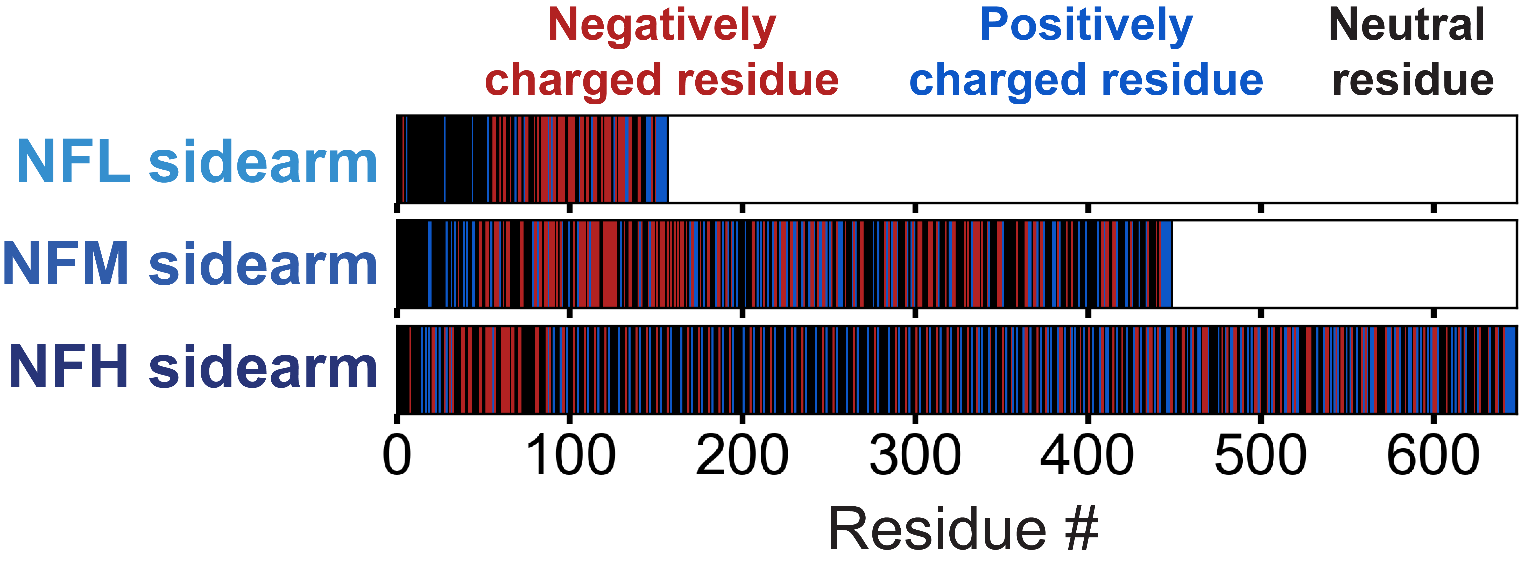


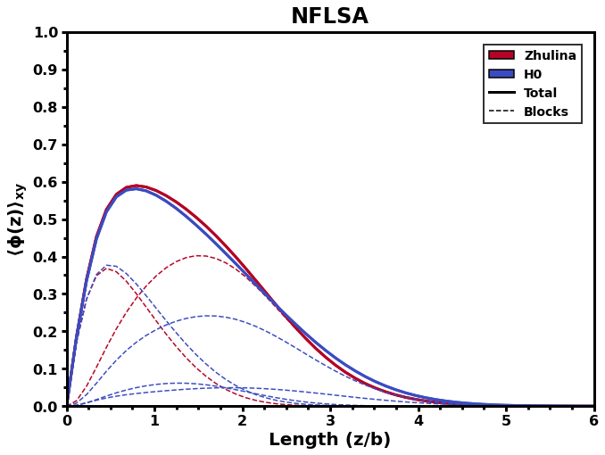
Zhulina
H0
\sigma = 1.0 chains/nm2
\chi smear = 0.60
Cs = 0.010M
H0: All H tags charge neutral
Block | H0 | Zh
1 | +0.0179 | +0.0400
2 | -0.2857 | -0.3585
3 | -0.4714
4 | 0.0000
 | Charge
H0 | Zh
1.0464 | 1.0840
0.7429 | 0.5660
0.5000
0.6375
Chi

Slide 7
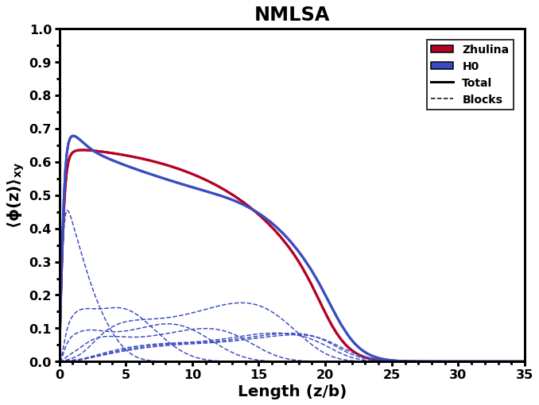
Zhulina
H0
\sigma = 1.0 chains/nm2
\chi smear = 0.60
Cs = 0.010M
H0: All H tags charge neutral
Block | H0 | Zh
1 | +0.0800 | -0.1406
2 | -0.2800
3 | -0.4400
4 | -0.2000
5 | 0.0000
6 | -0.3200
7 | 0.0000
8 | -0.0833
 | Charge
H0 | Zh
1.0120 | 0.7415
0.7400
0.5240
0.7280
0.6720
0.6680
0.8800
0.7792
Chi

Slide 8
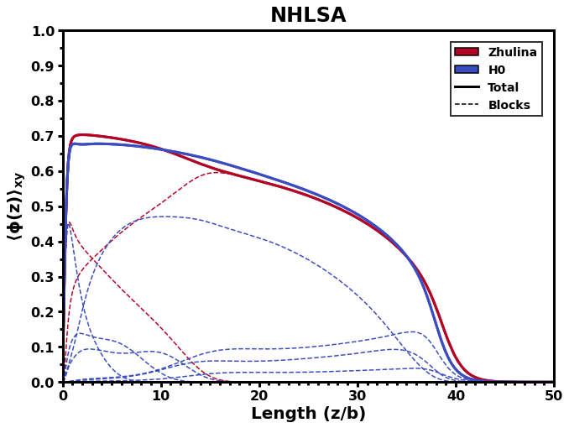
Zhulina
H0
\sigma = 1.0 chains/nm2
\chi smear = 0.60
Cs = 0.010M
H0: All H tags charge neutral
Block | H0 | Zh
1 | 0.0000 | -0.2100
2 | -0.3870 | 0.0256
3 | -0.2903
4 | +0.0403
5 | -0.0322
6 | +0.0103
7 | -0.1111
 | Charge
H0 | Zh
0.8581 | 0.7900
0.6516 | 0.9499
0.8903
1.0301
0.7452
0.6946
0.6593
Chi

Slide 9
Full Composite Brush

Slide 10
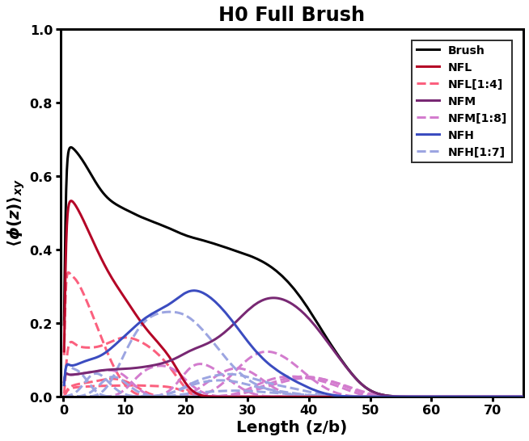
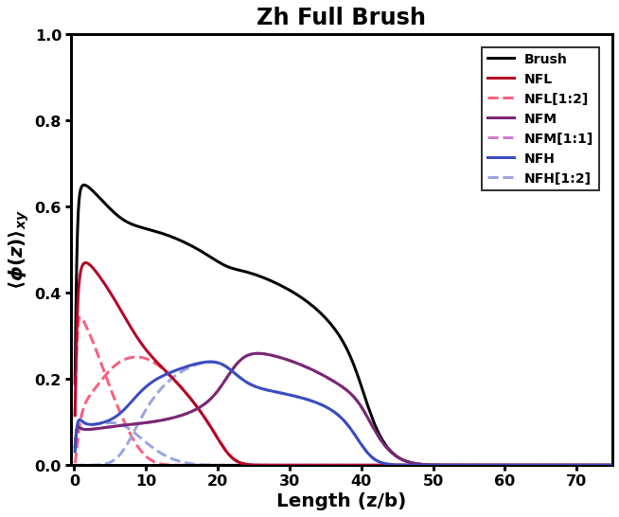
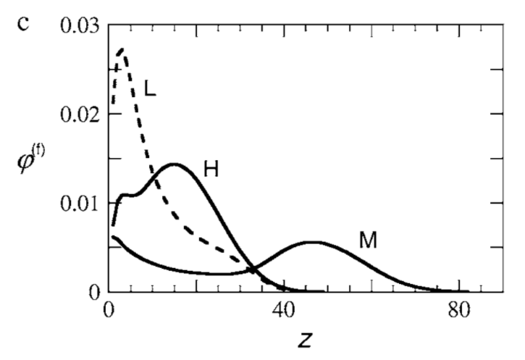
7:3:2 (L/M/H)
7:3:2 (L/M/H)
Chi = 0.60
Chi = 0.60
L
L
H
H = 54.3
H
H = 41.0
M
M
Zhulina, 2007
AA_{i} Hydrophobicities ignored
Differences:
Grafting density different
Contour length of AA = stiffness parameter
Good match
Notes:
H thresh at phA = 1e-03

Slide 11
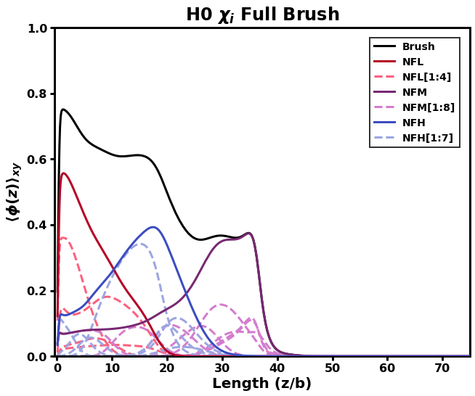
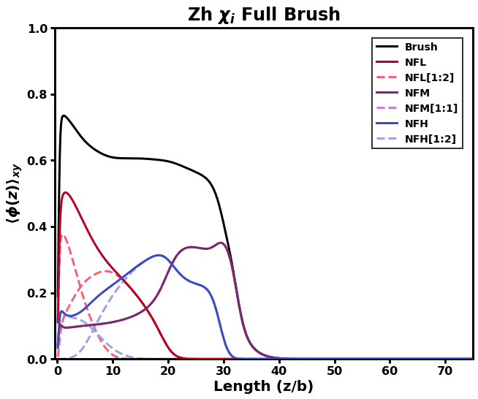
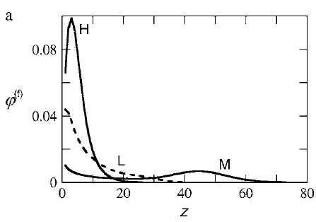
7:3:2 (L/M/H)
7:3:2 (L/M/H)
L
L
H
M
H
M
H = 45.56
H = 41.03
Zhulina, 2007
AA_{i} Hydrophobicities considered
Differences:
Grafting density different
Contour length of AA = stiffness parameter
Poor match: Grafting density a factor?
Notes:
H thresh at phA = 1e-03

Slide 12
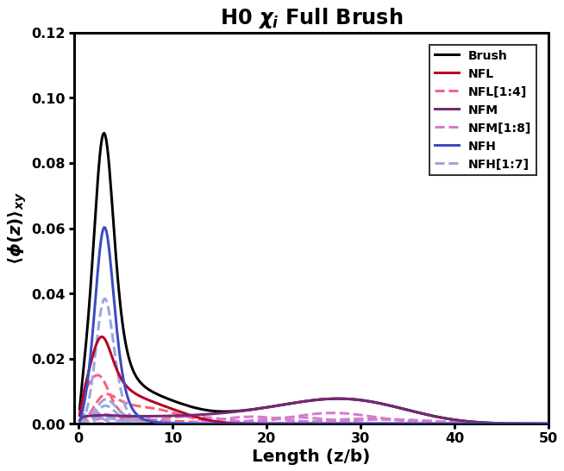
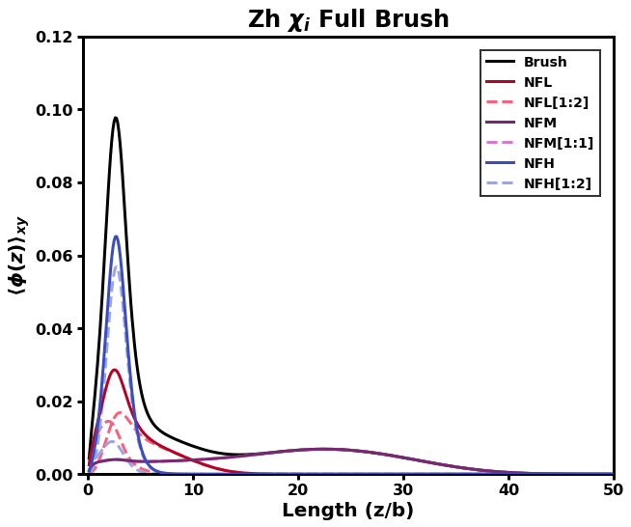
Zhulina, 2007
AA_i Hydrophobicity considered
Differences:
Grafting density different
Contour length of AA = stiffness parameter
Good match

Slide 13
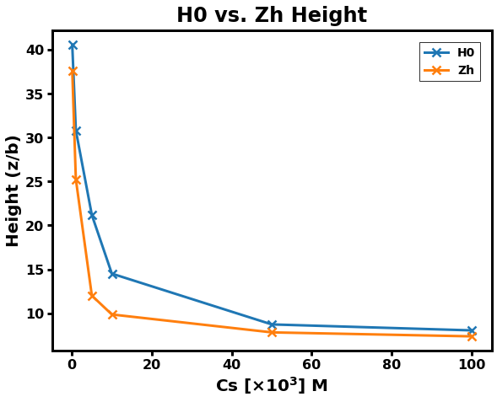
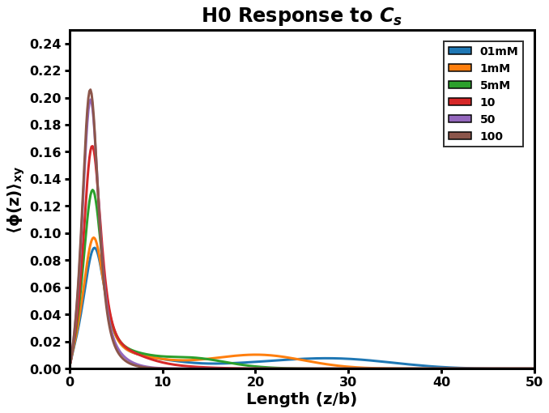
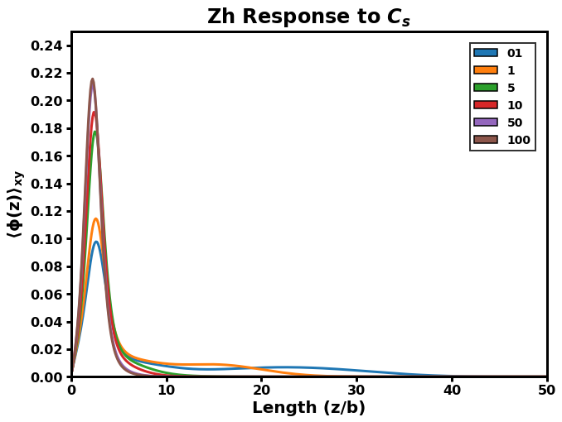
Despite similar shapes, response to Cs is different at intermediate Cs
“Height” Criterion: φ= 1.0e-3
“Height” Criterion: φ= 1.0e-3

Slide 14
Application to prev. published experimental data
Srinivasan 2014

Slide 15
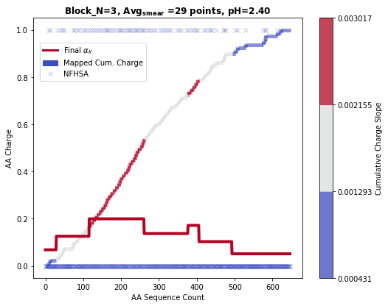
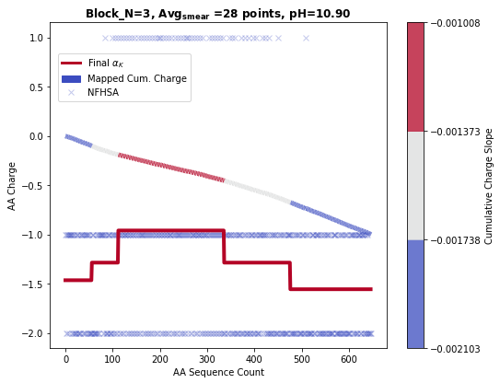
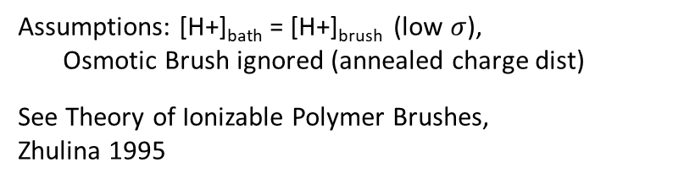
Effect of pH on charge dist.
Assumptions: [H+]_{bath} = [H+]_{brush} (low $σ$),
Osmotic Brush ignored (annealed charge dist)
See Theory of Ionizable Polymer Brushes, Zhulina 1995

Slide 16
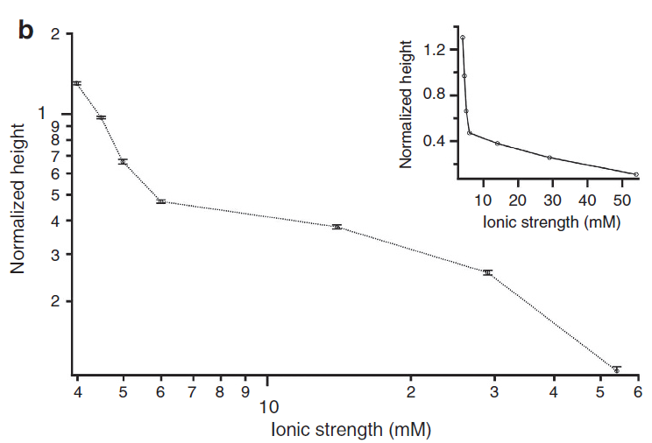
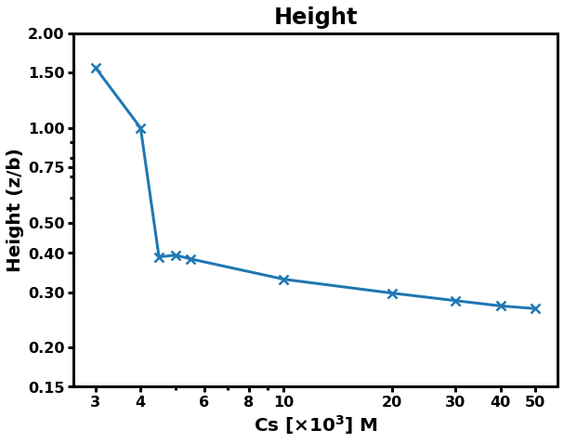
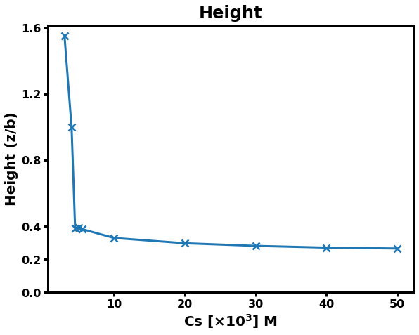
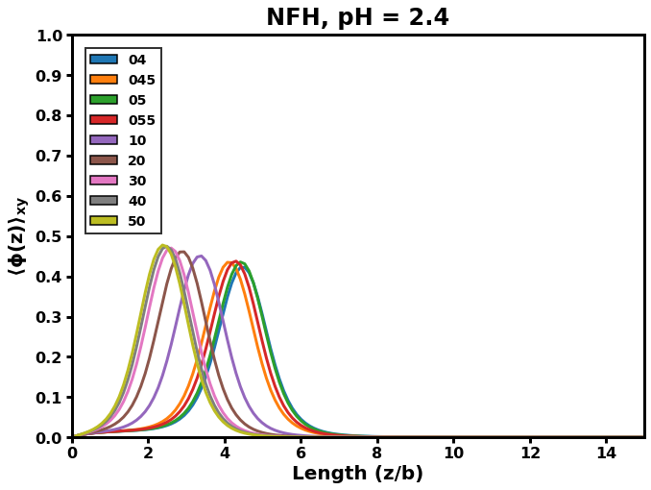
Srinivasan 2014, pH = 2.4, sigma = 0.02

Slide 17
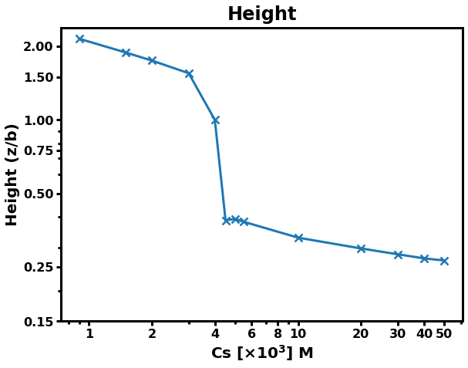
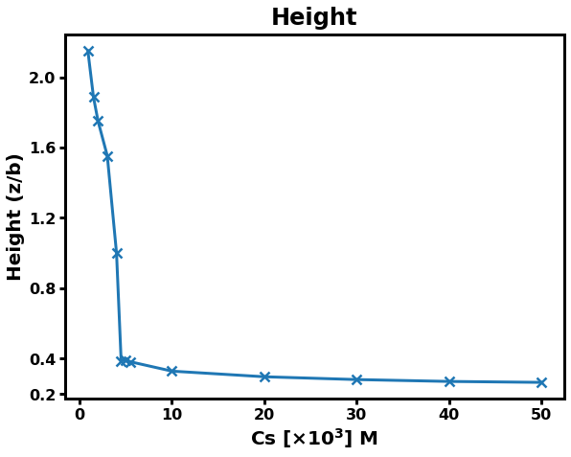
Extended Concentration values
Concentrations not included in paper

